Slide 1
The problem of overfitting
Regularization

Slide 2
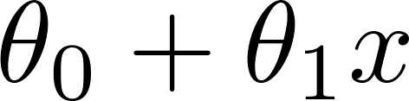
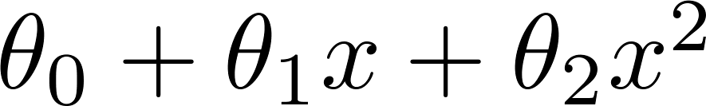
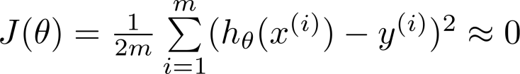
Example: Linear regression (housing prices)
Price
Price
Price
Size
Size
Size
Underfit “High Bias”
Overfitting: If we have too many features, the learned hypothesis may fit the training set very well ( ), but fail to generalize to new examples (predict prices on new examples).

Slide 3
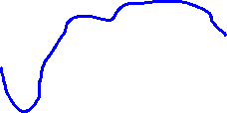
Example: Linear regression (housing prices)
Price
Price
Price
Size
Size
Size
Underfit “High Bias”
Overfit “High Variance”
Overfitting: If we have too many features, the learned hypothesis may fit the training set very well ( ), but fail to generalize to new examples (predict prices on new examples).

Slide 4
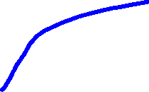
Example: Linear regression (housing prices)
Price
Price
Price
Size
Size
Size
Underfit “High Bias”
“Just right”
Overfit “High Variance”
Overfitting: If we have too many features, the learned hypothesis may fit the training set very well ( ), but fail to generalize to new examples (predict prices on new examples).

Slide 5
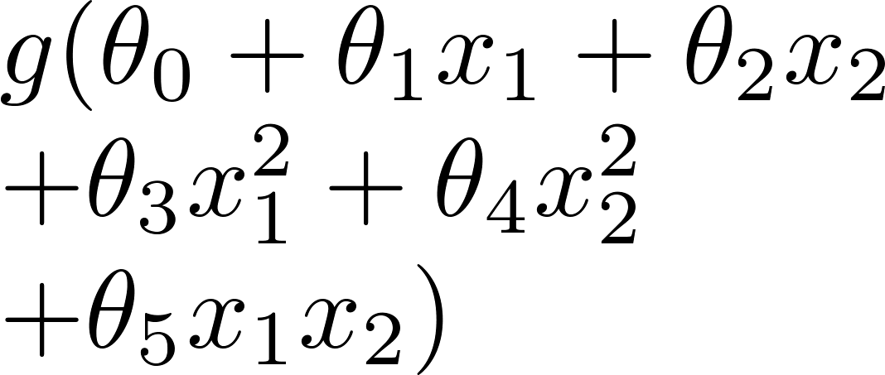
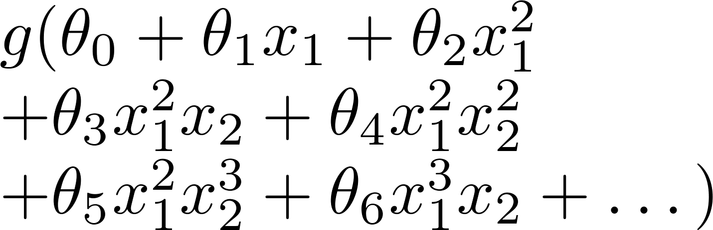
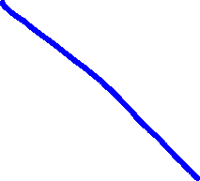
Example: Logistic regression
x₂
x₂
x₂
x₁
x₁
x₁
( = sigmoid function)
Underfit

Slide 6

Example: Logistic regression
x₂
x₂
x₂
x₁
x₁
x₁
( = sigmoid function)
Underfit
overfit

Slide 7
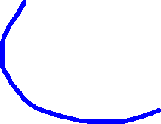
Example: Logistic regression
x₂
x₂
x₂
x₁
x₁
x₁
( = sigmoid function)
Underfit
overfit

Slide 8






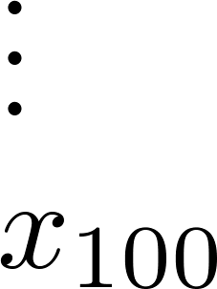
Addressing overfitting:
size of house
no. of bedrooms
Price
no. of floors
age of house
average income in neighborhood
Size
kitchen size

Slide 9


Addressing overfitting:
Options:
  Reduce number of features.
    Manually select which features to keep.
    Model selection algorithm (later in course).
  Regularization.
    Keep all the features, but reduce magnitude/values of parameters .
    Works well when we have a lot of features, each of which contributes a bit to predicting .

Slide 11
Cost function
Regularization

Slide 12


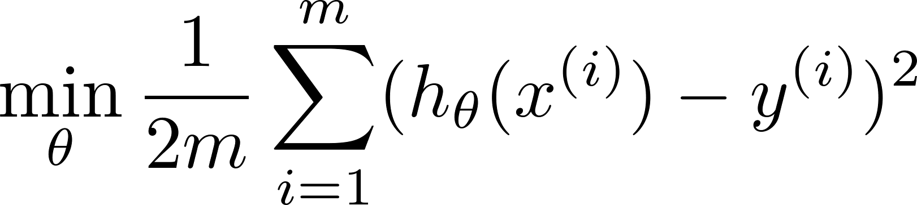
Intuition
Price
Price
Size of house
Size of house
Suppose we penalize and make , really small.

Slide 13
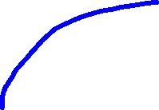
Intuition
Price
Price
Size of house
Size of house
Suppose we penalize and make , really small.

Slide 14
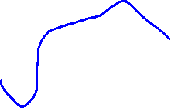
Intuition
Price
Price
Size of house
Size of house
Suppose we penalize and make , really small.

Slide 15



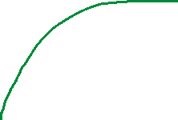

Intuition
Price
Price
Size of house
Size of house
Suppose we penalize and make , really small.

Slide 16

Intuition
Price
Price
Size of house
Size of house
Suppose we penalize and make , really small.
$$+1000θ_{3}^{2}+1000θ_{4}^{2}$$

Slide 17

Intuition
Price
Price
Size of house
Size of house
Suppose we penalize and make , really small.
$$+1000θ_{3}^{2}+1000θ_{4}^{2}$$
$$θ_{3}≈0 and{ θ}_{4}≈0$$

Slide 18
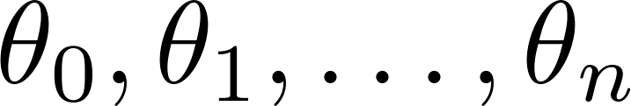
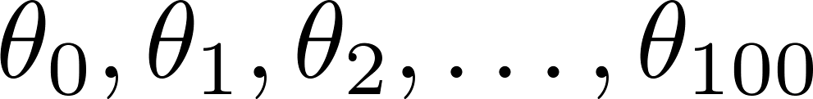
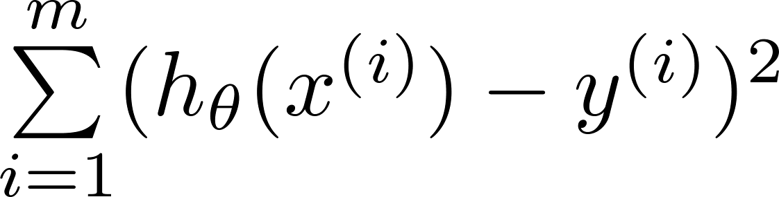
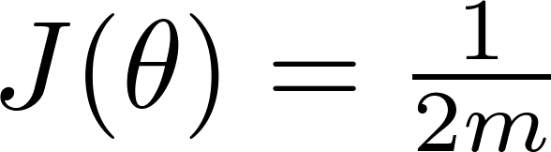
Regularization.
Small values for parameters
  “Simpler” hypothesis
  Less prone to overfitting
Housing:
  Features:
  Parameters:

Slide 19
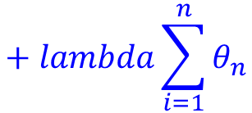
Regularization.
Small values for parameters
  “Simpler” hypothesis
  Less prone to overfitting
Housing:
  Features:
  Parameters:
$$+ lambda\sum_{i=1}^{n}{θ_{n}}$$

Slide 20
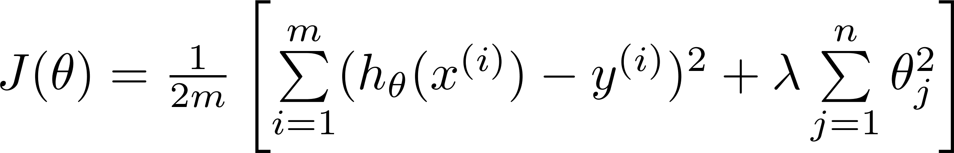
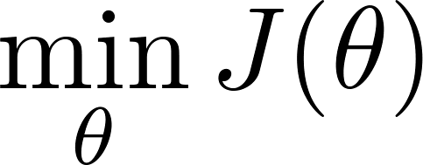
Regularization.
Price
Size of house

Slide 21


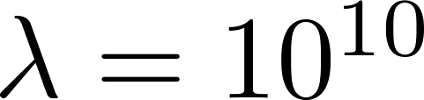
In regularized linear regression, we choose to minimize
What if is set to an extremely large value (perhaps for too large for our problem, say )?
Algorithm works fine; setting to be very large can’t hurt it
Algorithm fails to eliminate overfitting.
Algorithm results in underfitting. (Fails to fit even training data well).
Gradient descent will fail to converge.

Slide 22
In regularized linear regression, we choose to minimize
What if is set to an extremely large value (perhaps for too large for our problem, say )?
Price
Size of house

Slide 24

Regularized linear regression
Regularization
Machine Learning

Slide 25
Regularized linear regression

Slide 26

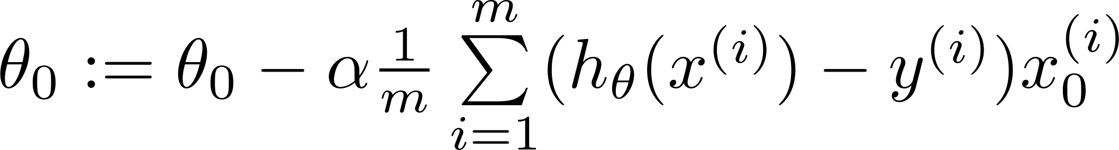
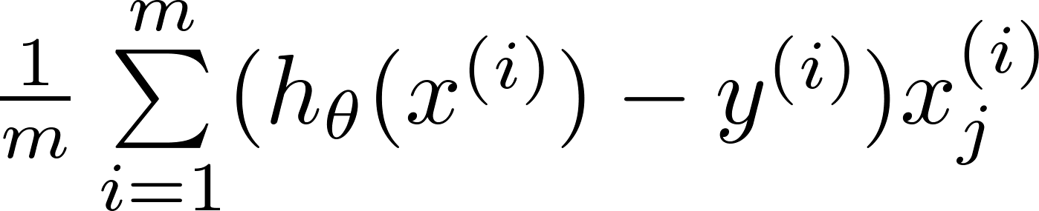
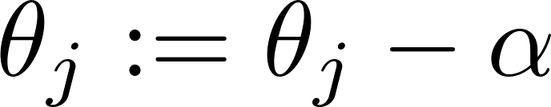


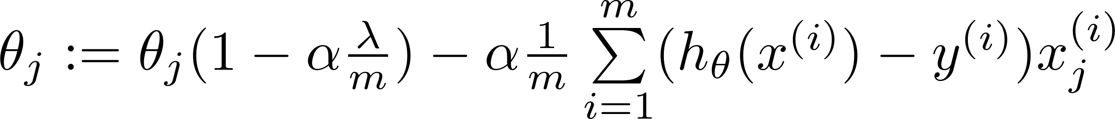
Gradient descent
Repeat

Slide 28
Regularized logistic regression
Regularization
Machine Learning

Slide 29
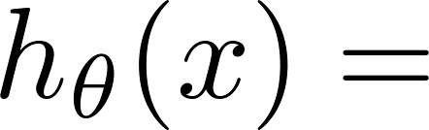
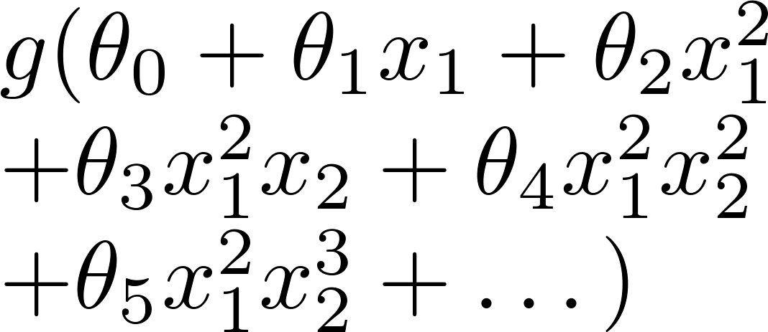
Regularized logistic regression.
x₂
x₁
Cost function:

Slide 30
Gradient descent
Repeat

